Slide 1
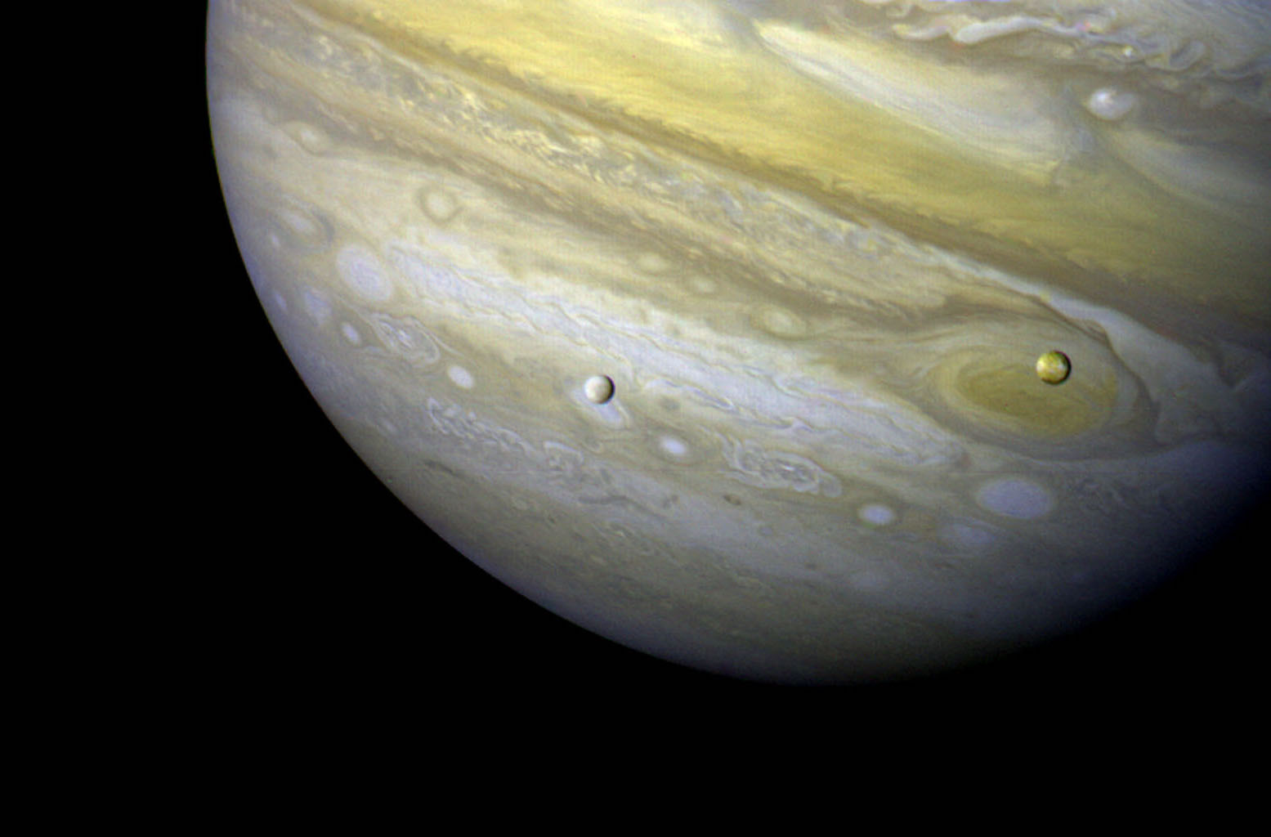
OpenCAE Case Study: Europa Lander Concept
Model-Based Systems Engineering Products in the OpenCAE Model-Based Engineering Environment with Europa Lander as a Case Study
January 2019 – INCOSE International Workshop – Torrance, CA, USA
Eric W Brower
Chris Delp, Robert Karban, Marie Piette, Ivan Gomes, Ellen van Wyk
The decision to implement the Europa Lander mission will not be finalized until NASA’s completion of the National Environmental Policy Act (NEPA) process. This document is being made available for information purposes only.
© 2019 California Institute of Technology. Government sponsorship acknowledged.

Slide 2
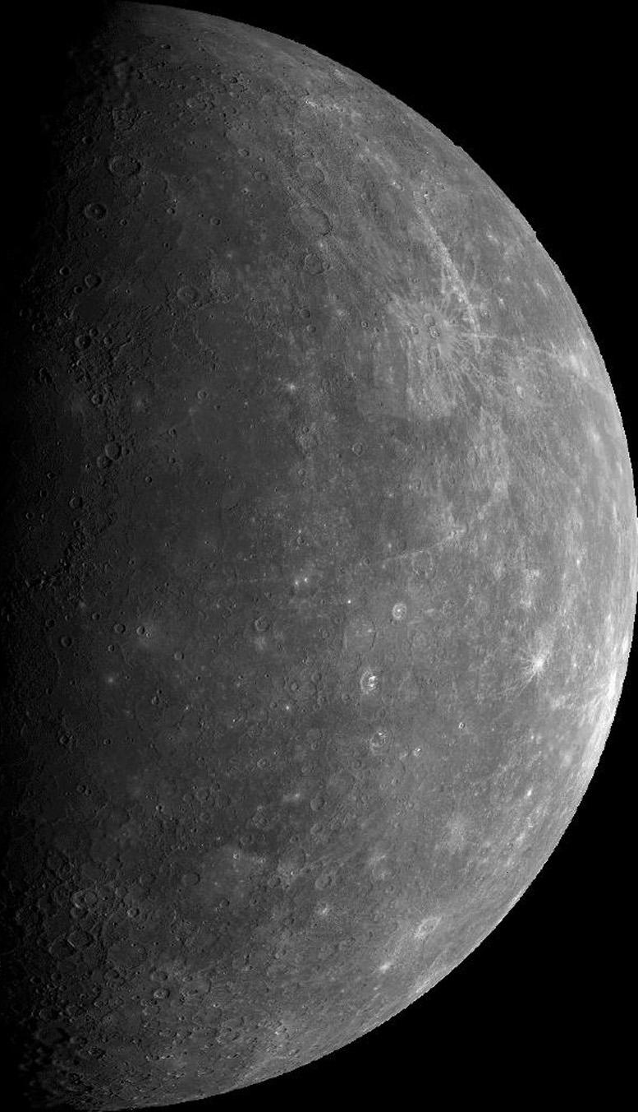
Agenda
OpenMBEE and OpenCAE
Europa Lander Adaptation Plan
JPL Systems Engineering Products
Europa Lander Systems Engineering Products

Slide 3
Open Model-Based Engineering Environment
openmbee.org
OpenMBEE is a community for open source modeling software and models
Number of open source software activities
Number of open source models
JPL is a participant and adopter of OpenMBEE software and models
Along with Boeing, Lockheed Martin, OMG, NavAir, Ford, Stevens, Georgia Tech, ESO
Vendor participants
~200 members

Slide 4
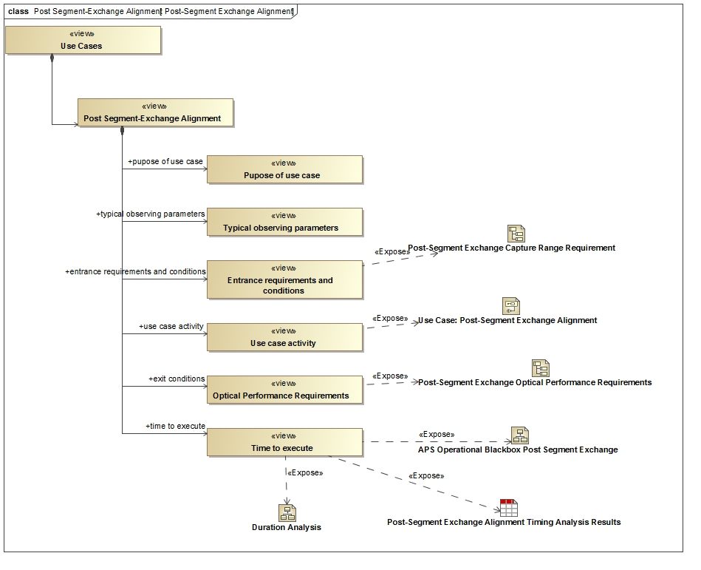
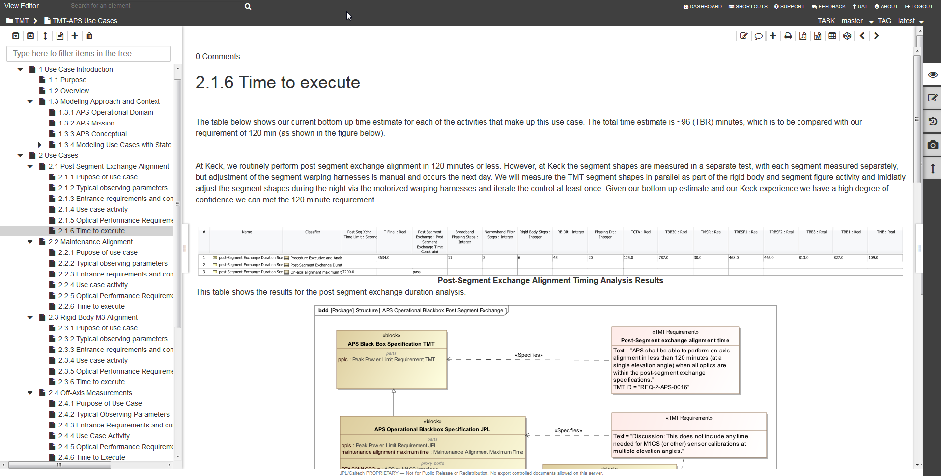
Core Integration of MMS, MDK, and VE
Model of Document in
MagicDraw/Model Development Kit
Model Repository
Rendered and editable document in Web interface View Editor

Slide 5
Computer Aided Engineering
CAE is divided into four engineering disciplines:
Electrical Engineering
Mechanical Engineering
Software Engineering
Systems Engineering
CAE supports the engineers of these disciplines with “engineering environments” – connected software applications and web services
“OpenCAE” refers to the core CAE team and its users

Slide 6
OpenCAE Systems Environment Overview
JIRA
NX/EPDM
DOORS NG
RAVEN
Systems Tool Kit
Syndeia
MapleMBSE
Analysis Orchestrator
Multi-Machine Analysis
OpenCAE DevOps
MATLAB
Maple
TMS
Syndeia Cloud
Artifactory
Tom Sawyer
Mathematica
DIY Web App
XL Release
Timelines
Maps
Artifacts
ModelCenter Cloud
MMS
Teamwork Cloud
Cameo Systems Modeler
Phoenix ModelCenter
Analyses
Indices
Models
MagicDraw + MDK
DARTS
View Editor
Web Services
Helix
Python

Slide 7
OpenCAE Systems Environment Overview
JIRA
NX/EPDM
DOORS NG
RAVEN
Systems Tool Kit
Syndeia
MapleMBSE
Analysis Orchestrator
Multi-Machine Analysis
OpenCAE DevOps
MATLAB
Maple
TMS
Syndeia Cloud
Artifactory
Tom Sawyer
Mathematica
DIY Web App
XL Release
Timelines
Maps
Artifacts
ModelCenter Cloud
MMS
Teamwork Cloud
Cameo Systems Modeler
Phoenix ModelCenter
Analyses
Indices
Models
MagicDraw + MDK
DARTS
View Editor
Web Services
Helix
Python

Slide 8
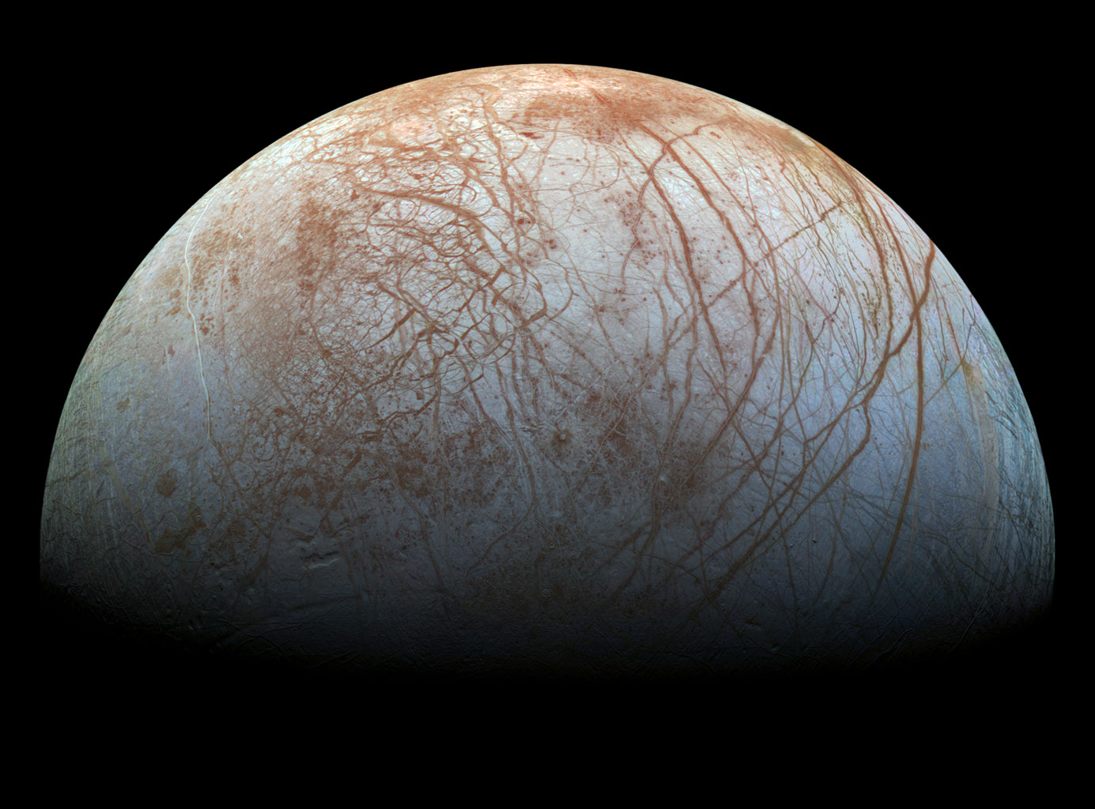
Europa Lander Study
Proposed astrobiology mission concept by NASA JPL
Europa is a moon of Jupiter
Salty ocean under icy surface
Bombarded by constant and intense radiation from Jupiter
390.4 million miles from Earth
Science Goals
Search for evidence of biosignatures on Europa
Assess the habitability of Europa
Characterize the surface and subsurface of Europa

Slide 9
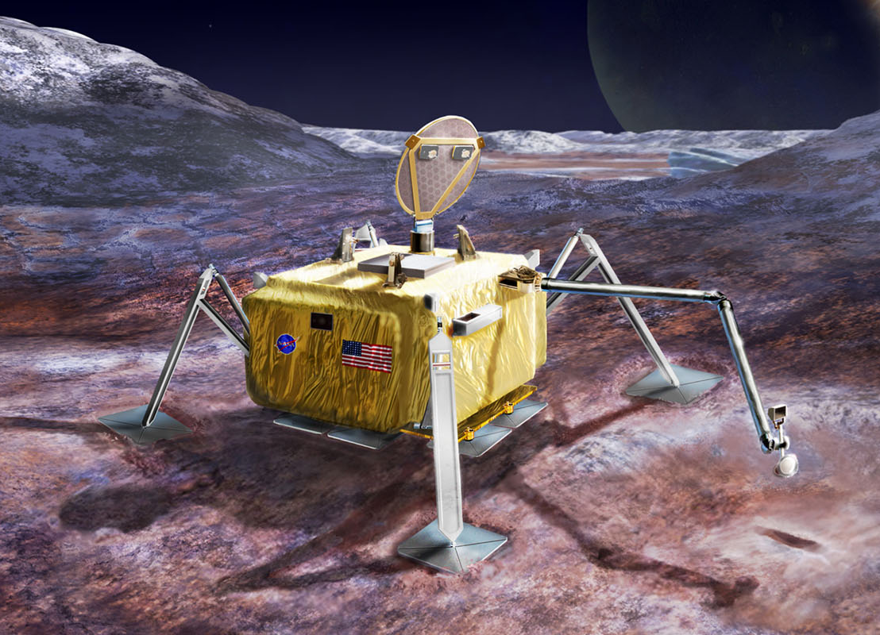

Europa Lander Environment Adaptation
MagicDraw + MDK
View Editor
Tom Sawyer
Phoenix ModelCenter
MapleMBSE
Syndeia
Web Services
Artist’s Concept

Slide 10
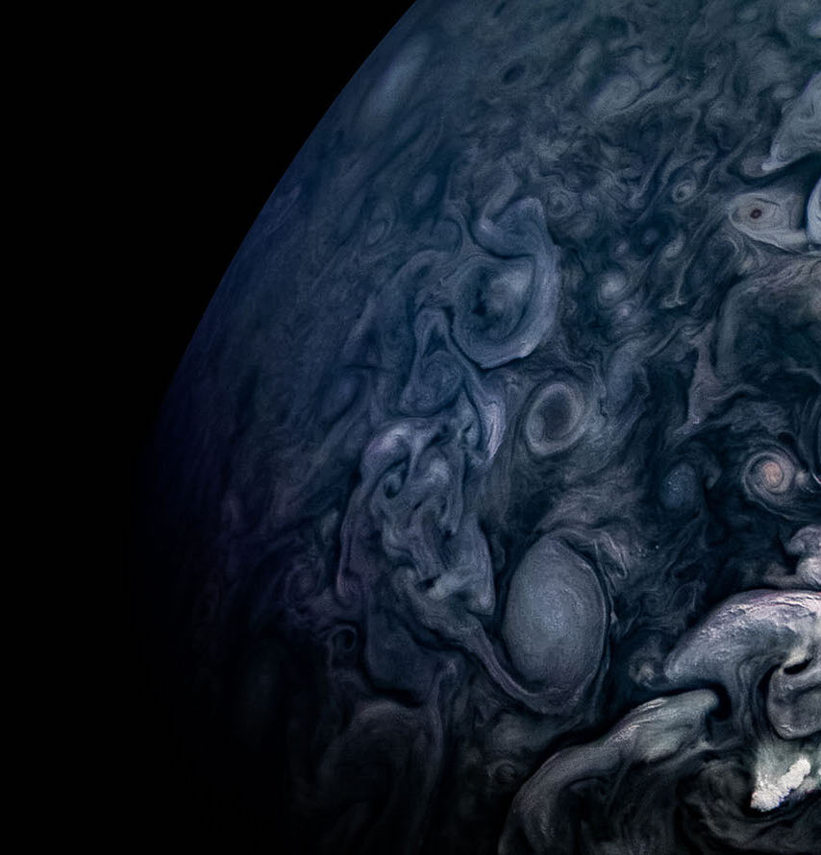
JPL Systems Engineering Products
Compositional System Design Capture
Electrical Flight Systems Engineering
System Block Diagram
Function Lists, Net Lists
Circuit Data Sheets
Scenario Definition, Planning and Analysis
Fault Protection Monitors and Responses
Functional Description Document Generation
Resource Management
Mass Management Process, Master Equipment List (MEL)
Power Scenario Analysis
Data Scenario Analysis
Equipment List

Slide 11
JPL Systems Engineering Products
Compositional System Design Capture
Electrical Flight Systems Engineering
System Block Diagram
Function Lists, Net Lists
Circuit Data Sheets
Scenario Definition, Planning and Analysis
Fault Protection Monitors and Responses
Functional Description Document Generation
Resource Management
Mass Management Process, Master Equipment List (MEL)
Power Scenario Analysis
Data Scenario Analysis
Equipment List

Slide 12
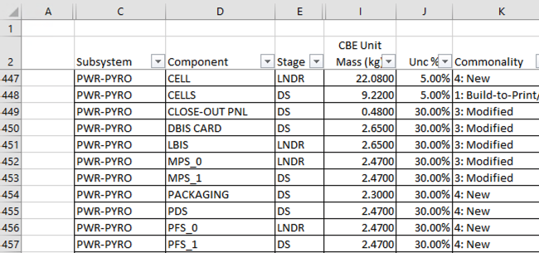
Master Equipment List (MEL)
Manages the flight system mass
Each component has the same list of mass attributes
Current Best Estimate (CBE)
Contingency percentage
Other metadata (point of contact, subsystem, stage)
MEL supplies all component types that can be used in the system design

Slide 13
Master Equipment List (MEL) Implementation
Encode all components as SysML Blocks
Store SysML Model in Teamwork Cloud
Version and Access Control
Branching and merging
Edit components with MapleMBSE
Spreadsheet Interface
Export and Import
Embedded Formulas for implied attributes
Link SysML components to CAD components with Syndeia
Control information between different modeling domains
Close information loop between Mechanical and Systems Engineering teams
MagicDraw + MDK
View Editor
Tom Sawyer
Phoenix ModelCenter
MapleMBSE
Syndeia
NX
Excel
Web Services

Slide 14
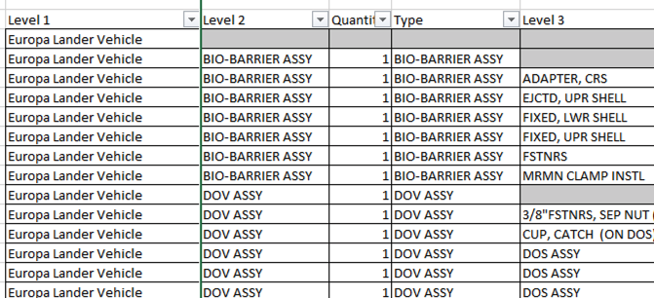
Compositional System Design
Describes the assembled structure of the spacecraft
MEL components are composed of other components
Tracks the rolled up mass of particular sections of the spacecraft
Reusages of common components that have the same attributes

Slide 15
Compositional System Design Implementation
Use components that are available in the SysML model
Describe composition hierarchy with Directed Composition Relationships
Expose assembled structure in MapleMBSE
Spreadsheet view of the composition hierarchy
Embedded formulas in Excel control the mass roll up
MagicDraw + MDK
View Editor
Tom Sawyer
Phoenix ModelCenter
MapleMBSE
Syndeia
NX
Excel
Web Services

Slide 16
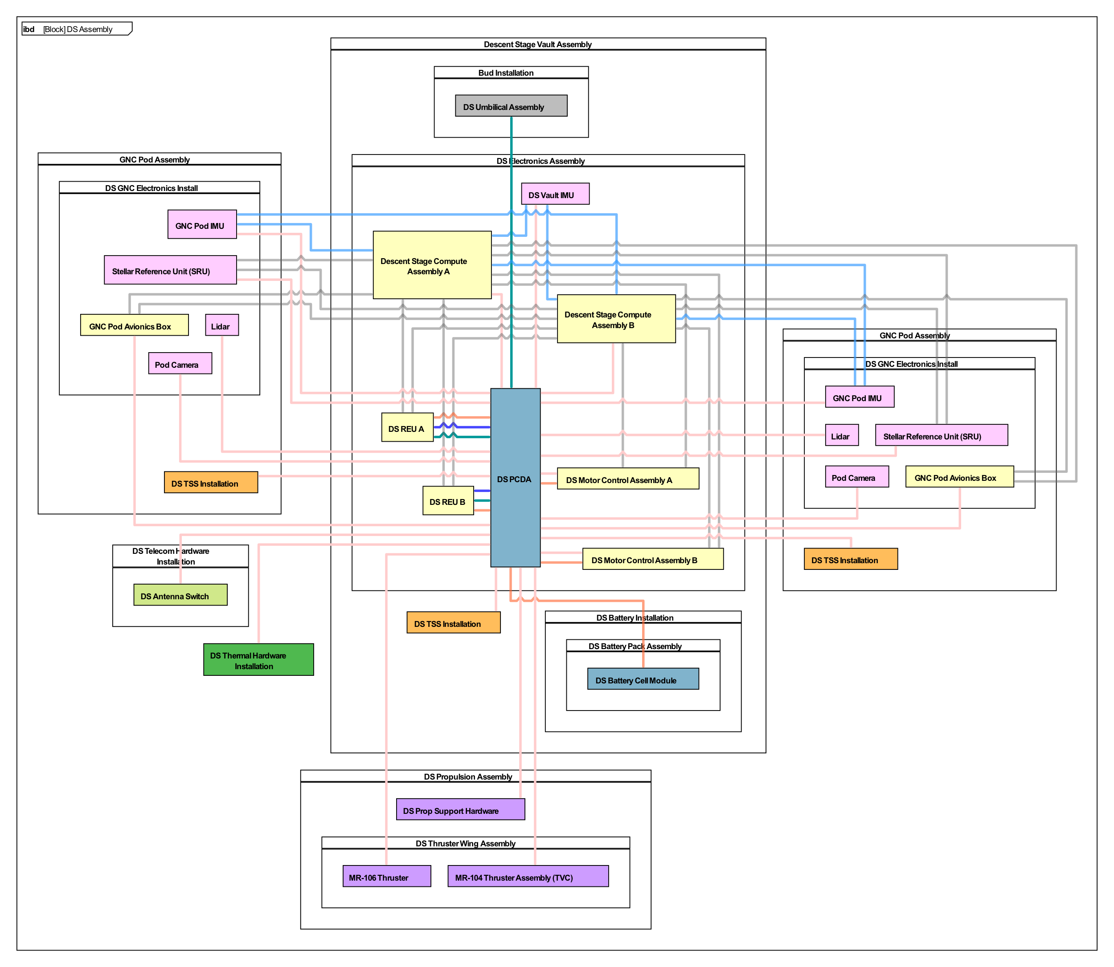
System Block Diagram
Deliverable for major reviews
Informs engineers about connected components in the spacecraft
Informs the available slots on components, based off of component type
Power connections
Data connections

Slide 17
System Block Diagram Implementation
Use MagicDraw to connect components
Validate connections with context
Create and apply connection types as necessary
Visualize with Tom Sawyer
Explore the connected elements with nested hierarchies
Interactive diagrams with filtering
Diagrams rendered from the model
Use MapleMBSE to audit all connections in table view
MagicDraw + MDK
View Editor
Tom Sawyer
Phoenix ModelCenter
MapleMBSE
Syndeia
Excel
Web Services

Slide 18
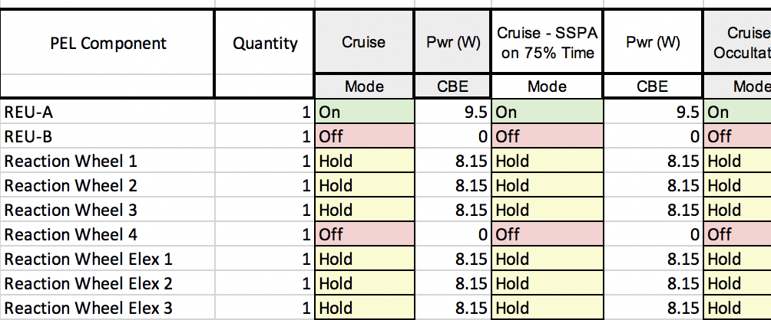
Scenario Definition and Power Equipment List (PEL)
Describes behavior of the spacecraft, with respect to power usage
A subset of all MEL components are powered
Powered components have a set of discrete modes with attributes
Power Usage
Contingency
Spacecraft performs certain tasks over a duration, described in scenarios
Scenarios prescribes each component’s mode during the scenario
Scenarios roll up the power usage of all the components based on attributes of the component modes

Slide 19
Scenario Definition and PEL Implementation
Use components that are available in the SysML model
Create new components that represent generic powered components
Power modes are inherited by the MEL components
Power modes contain their own attributes, which are inherited as well
Create new components that represent Scenarios
Expose powered components in MapleMBSE
Spreadsheet view
Power roll up on discrete scenarios
Table are used in Phoenix for Monte Carlo analysis
MagicDraw + MDK
View Editor
Tom Sawyer
Phoenix ModelCenter
MapleMBSE
Syndeia
Excel
Web Services

Slide 20
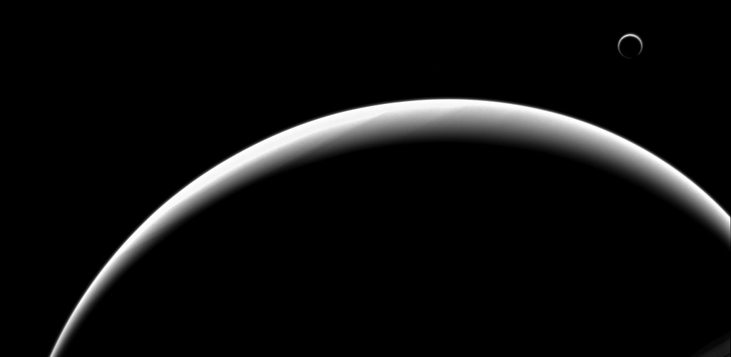
Accomplishments
OpenCAE Systems Environment supports the engineering effort on Europa Lander
We took a model-based engineering approach to developing the standard JPL systems engineering products
CAE improved the engineering environment for all users based off of findings during this effort

Slide 21
Bibliography
Hand, K.P., Murray, A.E., Garvin, J.B., Brinckerhoff, W.B., Christner, B.C, Edgett, K.S, Ehlmmann, B.L., German, C.R., Hayes, A.G., Hoeler, T.M., Horst, S.M., Lunine, J.I., Nealson, K.H., Paranicas, C., Schmidt, B.E., Smith, D.E., Rhoden, A.R., Russell, M.J., Templeton, A.S., Willis, P.A., Yingst, R.A., Phillips, C.B, Cable, M.L., Craft., K.L., Hofmann, A.E., Nordheim, T.A., Pappalardo, R.P., and the Project Engineering Team (2017): Report of the Europa Lander Science Definition Team. Posted February, 2017.
Karban, R., Dekens, F., Herzig, S., Elaasar M., Jankevicius, N., “Creating systems engineering products with executable models in a model-based engineering environment”, SPIE, Edinburgh, Scotland, 2016
Karban, R., Jankevičius, N., Elaasar, M. “ESEM: Automated Systems Analysis using Executable SysML Modeling Patterns”, INCOSE International Symposium (IS), Edinburgh, Scotland, 2016
Karban, R. “Using Executable SysML Models to Generate System Engineering Products”, NoMagic World Symposium, 2016
Trancho, G., Analyzing the Operational Behavior of NFIRAOS LGS MCAO, Acquisition on the Thirty Meter Telescope using SysML
Analyzing the Operational Behavior of the Alignment and Phasing System of the Thirty Meter Telescope using SysML Sebastian J. I. Herzig, Robert Karban, Gelys Trancho, Frank G. Dekens, Nerijus Jankevicius, and Mitchell Troy, Adaptive Optics for Extremely Large Telescopes, Tenerife, 2017
Model-based spacecraft fault management design & formal validation
Corrina Gibson, Michael Bonnici, Jean-Francois CastetPublished 2015 in 2015 IEEE Aerospace Conference
Abstractions for Executable and Checkable Fault Management Models, Corrina Gibson, RobertKarban, Luigi Andolfato, John Day, 2014 Conference on Systems Engineering Research
Corrina Gibson, Robert Karban, Luigi Andolfato and John Day. Formal Validation of Fault Management Design Solutions, JPF Workshop 2013
Open Source TMT model: https://github.com/Open-MBEE/TMT-SysML-Model
Open Source Engineering Environment: openmbee.org
A Practical Guide to SysML, 3rd Edition, Chapter 17 by Friedenthal, Moore, and Steiner
https://www.jpl.nasa.gov/spaceimages/
Satellite by Made by Made from the Noun Project

